Slide 1
TABLETS & SUPPOSITORIES
BY
DR.G.AARTHIPRIYANKA
POST GRADUATE
DEPARTMENT OF PHARMACOLOGY

Slide 2
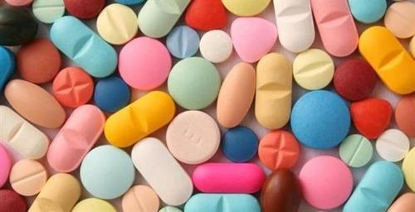
TABLETS
Solid dosage forms
Active drugs with or without diluents, prepared by compression or by molding method.
Shapes:
Discoid
Round
Oval
Oblong
Cylindrical
Triangular
They have grooves/lines/scores to facilitate breaking

Slide 3
ADVANTAGES
Simple,
Economical,
Stable,
Convenient to Carry,
Accurate,
Easy for Administration &
Most popular dosage forms

Slide 4
DIFFERENT TYPES OF TABLETS
Simple uncoated oral tablets
Sugar coated tablets
Enteric coated tablets
Mouth dissolving/orally disintegrating tablets
Dispersible tablets
Chewable tablets
Buccal & Sublingual tablets
Lozenges & Troches
Sustained release/ Extended release tablet (SR/ER)
Suppositories
Urethral inserts/Bougies

Slide 5
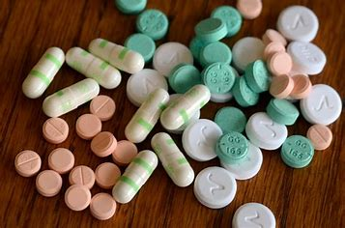
SIMPLE UNCOATED ORAL TABLETS
Designed without outer coatings
Disintegrates in the stomach
Dissolves in gastric juice

Slide 6
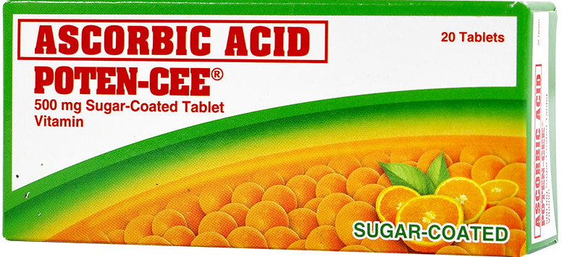
SUGAR COATED TABLETS
Coated with sugar layer which masks disagreeable taste or odor.
50% larger and heavier than original uncoated tablets
E.g.,Multi vitamin tablets

Slide 7
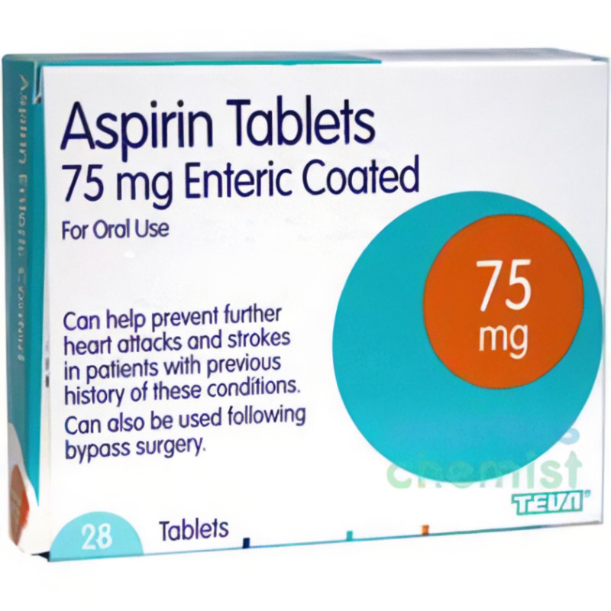
ENTERIC COATED TABLETS
Coated with hydroxy propyl methyl cellulose phthalate,
poly vinyl acetate phthalate,
Cellulose Acetate phthalate,
Which resist gastric acid in stomach but disintegrates in
Alkaline medium of intestine.
Employed when drug is destroyed by gastric acid/irritanting to Gastric mucosa/or to Bypass Stomach to enhance absorption in intestine.

Slide 8
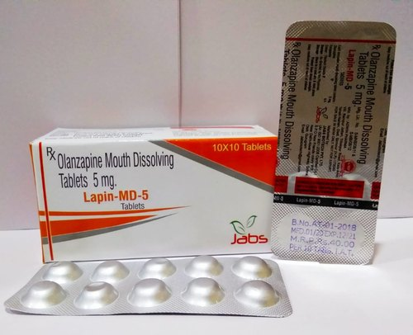
MOUTH DISSOLVING TABLETS
Disintegrate in the mouth very fast
Liquefy on tongue
Do not require water
Designed for paediatric,Geriatric,Dysphagic,
Bed-ridden,travelling & psychiatric patients

Slide 9
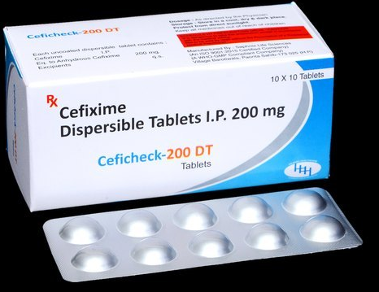
DISPERSIBLE TABLETS
Dispersed in food/water/milk (3 min)
Quicker onset
Children & Elderly with dysphagia
Should be used immediately after removal from
package as they are more sensitive to moisture

Slide 10
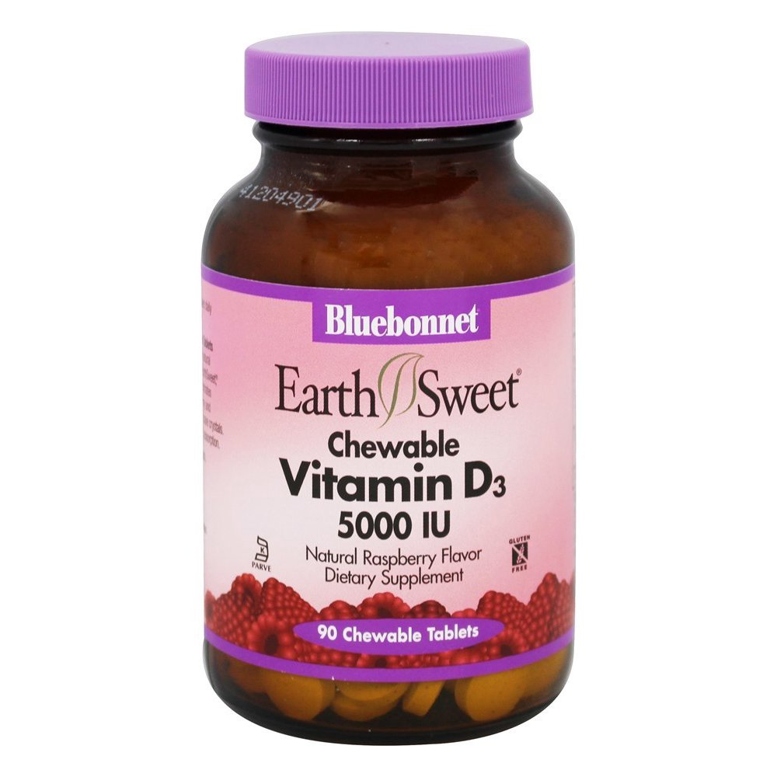
CHEWABLE TABLETS
Chewed in the mouth prior to swallowing
Large sized tablets

Slide 11
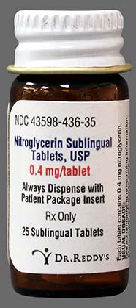
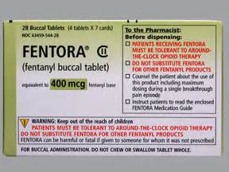
BUCCAL & SUBLINGUAL TABLETS
Buccal pouch/beneath tongue for systemic absorption from gastric mucosa
Rapid onset of action – Bypass liver
Should not promote salivation,
which increases swallowing

Slide 12
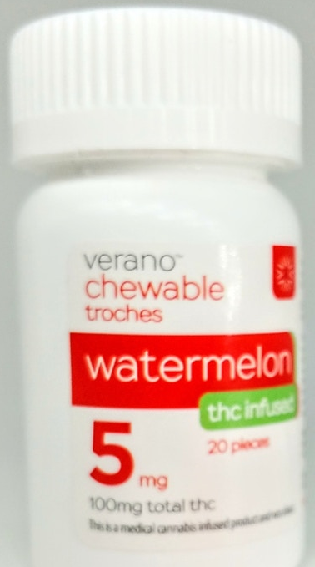
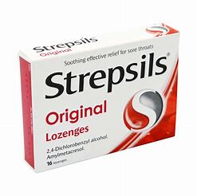
LOZENGES & TROCHES
Flavouring substance in sugar base
Local action on Throat – Lozenges
Local action on Mouth – Troches
Anti-septics,anti-inflammatory,local anaesthetics,
Anti-fungal agents

Slide 13
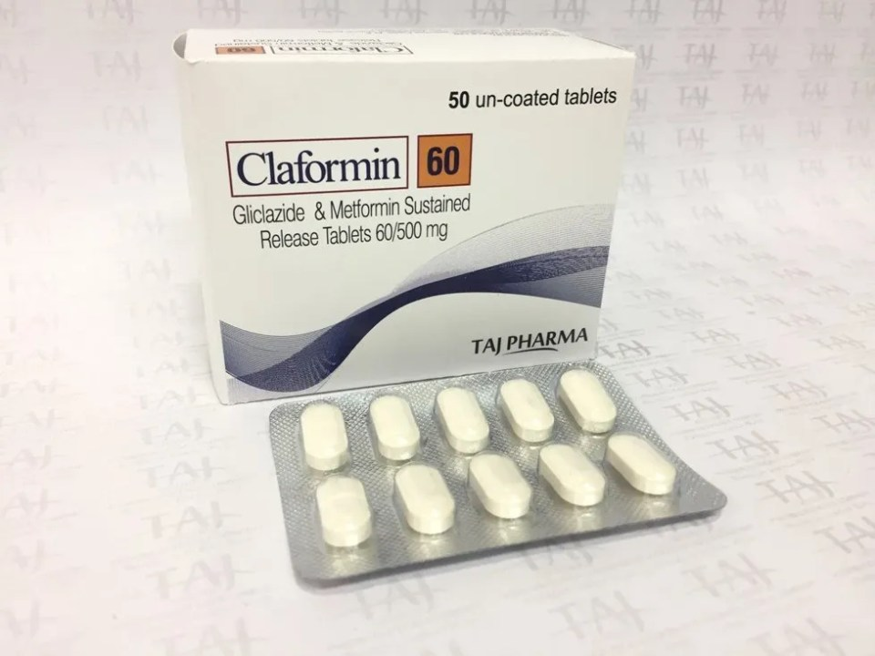
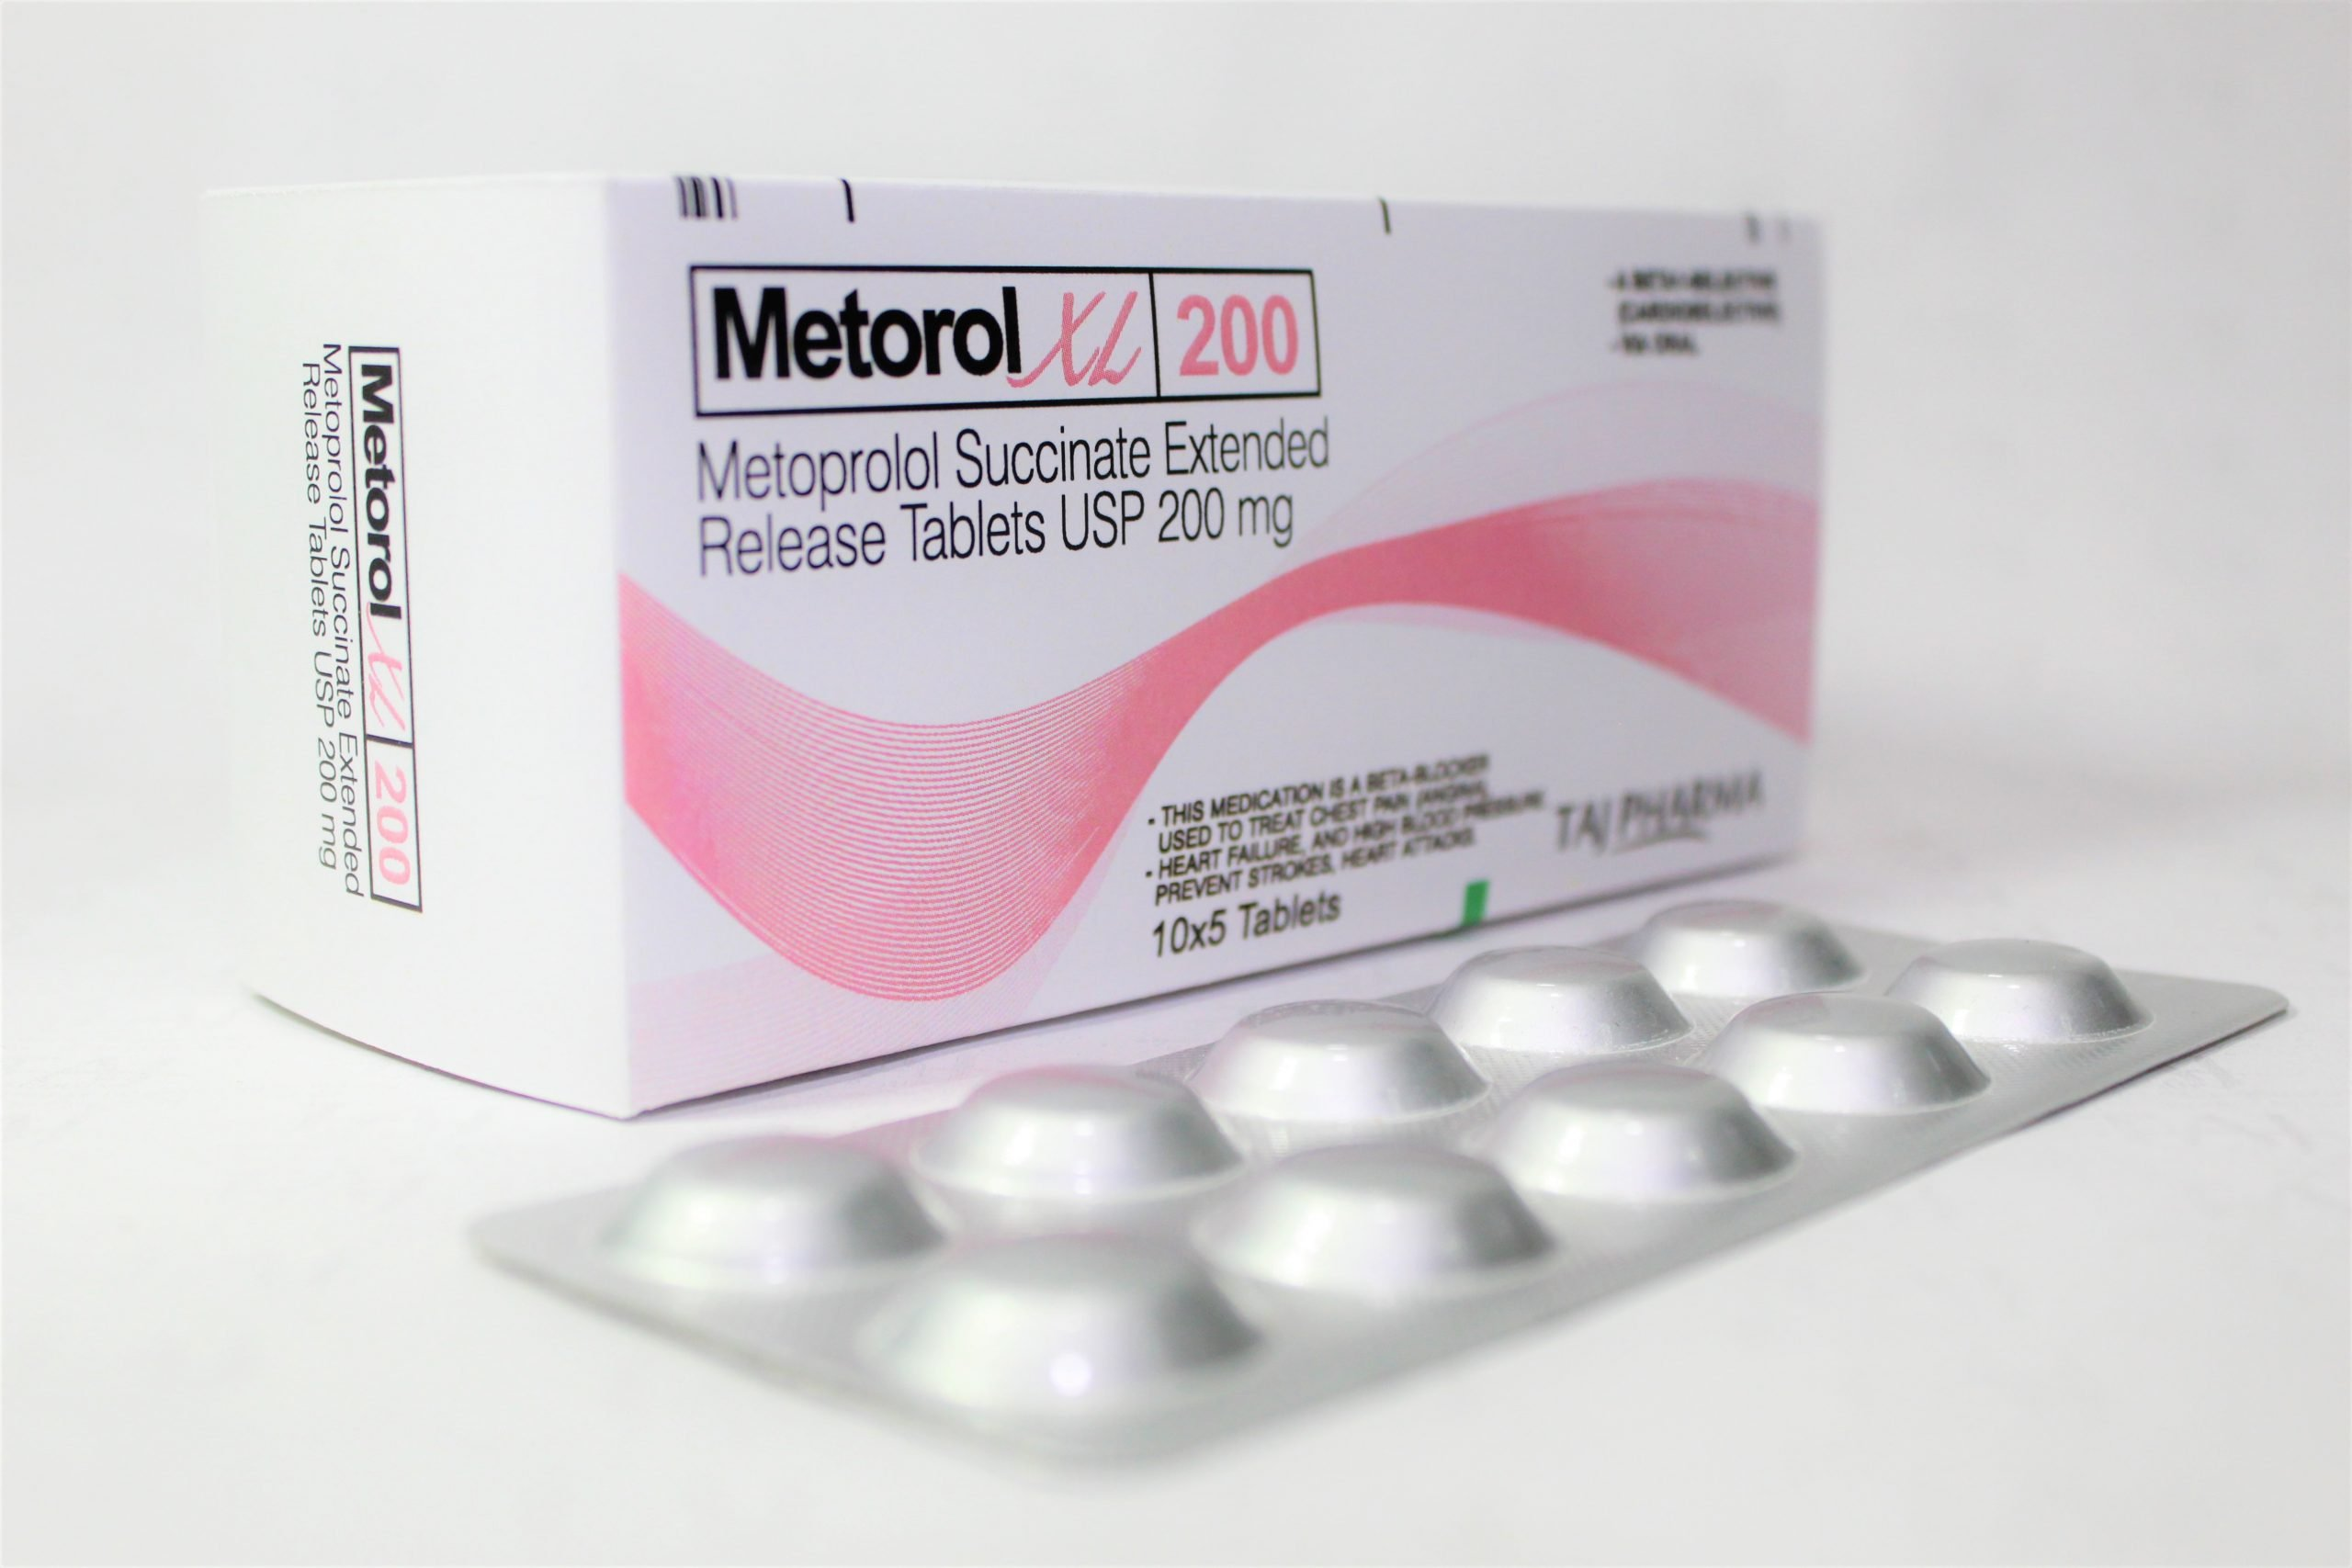
SUSTAINED RELEASE/EXTENDED RELEASE TABLETS
Release drug in GIT for prolonged period of time
Initially,part of drug released to provide immediate relief,
followed by Gradual release of smaller amounts for maintanence
ADVANTAGES:
Decrease blood level fluctuations
Dosing frequency
Adverse effects
Health costs
Improve the efficacy

Slide 14
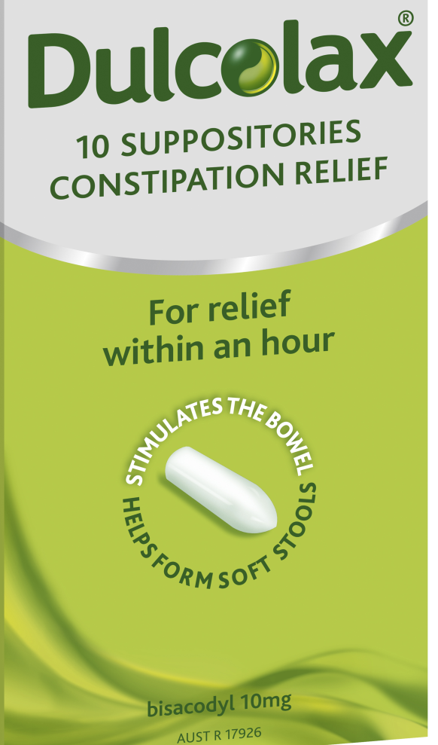
SUPPOSITORIES
Insertion into body cavities – Rectum, vagina & urethra
Where they melt or dissolve to produce local action
Vaginal suppository - Pessary

Slide 15
URETHRAL INSERTS/BOUGIES
Slender pencil shaped urethral suppositories
E.g.,Alprostadil inserts for erectile dysfunction

Slide 16
CAPSULES
Enclosed in a small shell of Gelatin
Gelatin dissolves on swallowing so that drug is released in GIT

Slide 17
DIFFERENT TYPES OF CAPSULE
Hard capsule
Soft capsule
Spansules

Slide 18
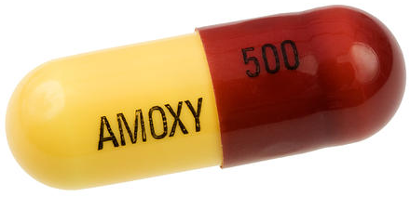
HARD CAPSULE
2 pieces- long body & shorter cap.
E.g., Amoxicillin Capsules

Slide 19
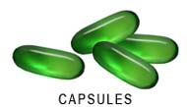
SOFT CAPSULE
1 piece –various shapes
E.g., Vit E capsules

Slide 20

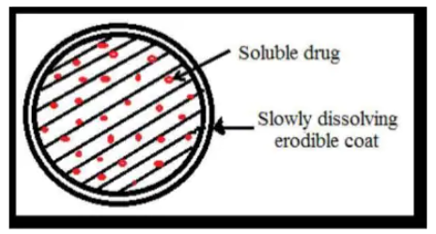
SPANSULES
Capsules containing drug granules with special pharmaceutical formulation to be disintegrated & dissolved at different times for prolonged duration of action.
E.g., Sustained release capsule of Ferrous Sulphate

Slide 21
ENTERIC COATED TABLETS
1. Identify The Given Dosage Form. Define Tablets.
Enteric Coated Tablets. Tablets May Be Defined As Solid Dosage Forms Meant For oral Administration, prepared By Compression/Moulding Of One Or More Medicaments.

Slide 22
2. Enumerate Different Types Of Tablets:
Simple Uncoated oral Tablets
Sugar Coated Tablets
Enteric Coated Tablets
Mouth Dissolving Tablets
Dispersible Tablets
Chewable Tablets
Sublingual Tablets
Sustained Release Tablets
Lozenges

Slide 23
3. What Are The Advantages Of Enteric Coated Tablets ?. Give 2 Examples
They Resist Dissolution In Gastric Juice & Release The Drug In The Intestine. They Are Employed When
The Drug Is Destroyed By Gastric Acid Or Is Irritant To Gastric Mucosa.
Eg., Enteric Coated Aspirin --- To Prevent Irritation To Gastric Mucosa
Enteric Coated PPI --- To Prevent Degradation By Gastric Acid

Slide 24
SPANSULES
1. Identify & Describe The Given Dosage Form:
Spansules( Sustain Release Capsules ). They Are Hard Gelatin Capsules Filled With Granules With
Specific Formulation To Disintegrate & Dissolve At Different Times & Thereby Providing Uniform
Medication Over A Prolonged Period Of Time.

Slide 25
2.What Are Capsules? Describe Different Types Of Capsules
Solid Oral Dosage Forms That Contain One Or More Medicaments Enclosed Within Shells Of Gelatin.
Hard Gelatin Capsules : Made Up Of 2 pieces Fit Together –A long Body & A Shorter Cap. Used For Packing Powders & Granules.
Soft Gelatin Capsules : One Piece Capsule . Contains Liquids/Semisolids.

Slide 26
3. What Are The Advantages Of Sustained Release Capsules ?
Maintain Consistent Therapeutic Effect For a Longer Time
Less Frequent Dosing
Reduction In Adverse Effects.

Slide 27
SUPPOSITORIES
1.Identify & Describe The Given Dosage Form
Rectal Suppositories. Suppositories Are Solid Dosage Form Intended For Insertion Into body Cavities
Like Rectum, Vagina & Urethra Other Than Mouth.

Slide 28
2. What Are The uses Of Suppositories?
To produce Local Action --- Eg., Bisacodyl Rectal Suppository For constipation.
To Produce Systemic Action --- Eg.,Diazepam Rectal Suppository For Febrile Convulsions In Children.

Slide 29
3. What Is A Pessary?
It Is Solid Dosage Form Specifically Shaped To Be Inserted Into The Vagina With The help Of An Applicator. It is intended For Local Action. It Is Also Called A Vaginal Suppository Or Vaginal Tablet.
Eg., Clotrimazole Pessary For Vaginal Candidiasis.

Slide 30
THANK YOU

